Slide 1
Hominid Evolutionary Pathways

Slide 2
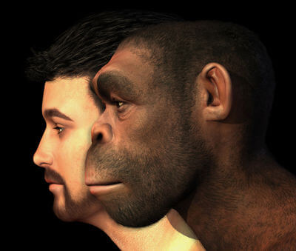
Objectives
In this Smart Lesson you will look at the characteristics of various ancient hominids, and will determine relatedness and possible evolutionary pathways by comparing to modern humans and great apes.

Slide 3
Ancient Man
The first ancient human fossils were found in the 19th century. Since then hundreds of fossils have been found, largely in Africa. As many fossils are just small fragments of a skeleton, it is a lengthy and challenging process to reconstruct the details of these ancient humans.
By looking at features such as brain capacity; shape of skull, including jaw and dentition; the shape of the pelvis; bone structure of hands and feet and height of the specimens, the ancient hominids can be compared to modern humans and apes.
There are many different thoughts as to how humans have evolved, and which are our direct ancestors, or which are lines which died out. We will look at the features of some of the key species to try and determine possible evolutionary pathways.

Slide 4
Hominid Species
There are many different species of ancient hominids found in the fossil record.
You will be considering the following 7 species:
Australopithecus afarensis
Australopithecus africanus
Paranthropus robustus
Homo erectus
Homo neanderthalensis
Homo sapiens

Slide 5
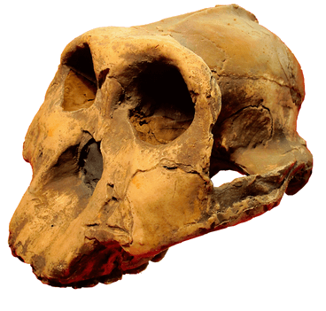
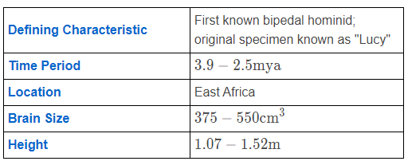
Australopithecus afarensis
Facts about Australopithecus afarensis:
• | No chin
• | Ape-like face
• | Flat nose
• | Prognathic jaws
• | Canines smaller than modern apes
• | Large molars
• | Large sexual dimorphism

Slide 6
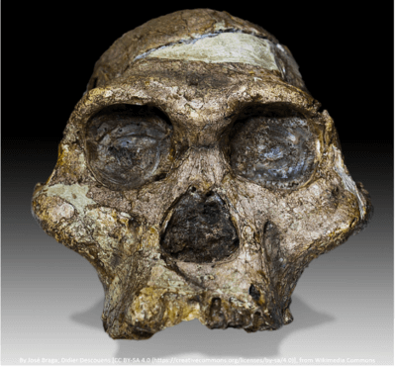
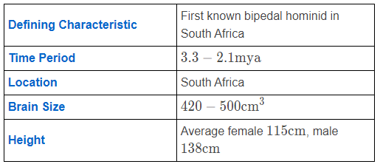
Australopithecus africanus
Facts about Australopithecus africanus:
• | No chin
• | Ape-like face
• | Rounder cranium than A.afarensis
• | Flat nose
• | Prognathic jaws
• | Canines smaller than modern apes
• | Large molars
• | Large sexual dimorphism

Slide 7
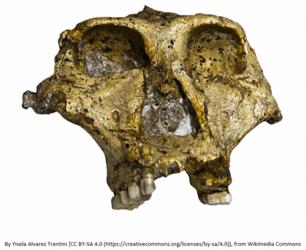
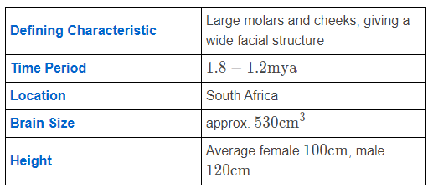
Paranthropus robustus
Facts about Paranthropus robustus:
• | No chin
• | Ape-like face
• | Very broad face
• | Flat nose
• | Prognathic jaws
• | Canines smaller than modern apes
• | Large molars

Slide 8
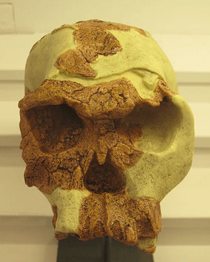
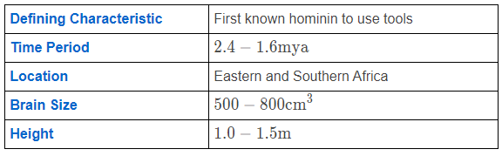
Homo habilis
Facts about Homo habilis:
• | Hips form a distinct pelvis bowl
• | Smaller teeth and jaws
• | Dentition indicates more meat in the diet
• | Close to modern humans in size
• | Males and females similar in size

Slide 9
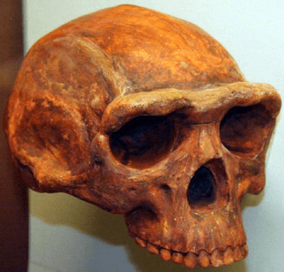
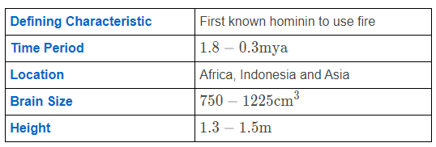
Homo erectus
Facts about Homo erectus:
• | Sophisticated stone tool makers
• | Meat formed a significant part of their diet
• | Rib-cage was barrel shaped

Slide 10
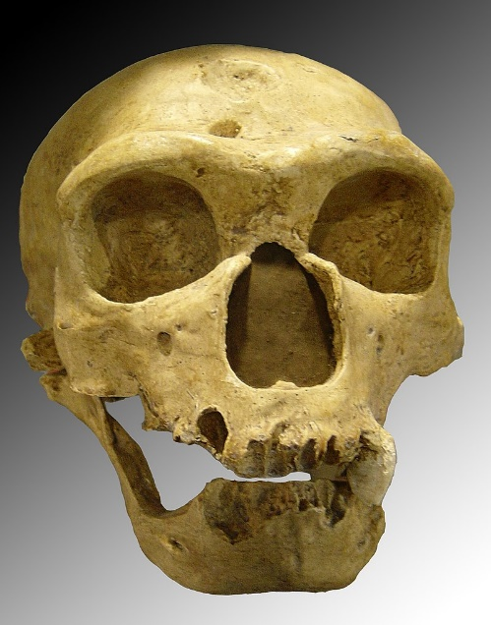
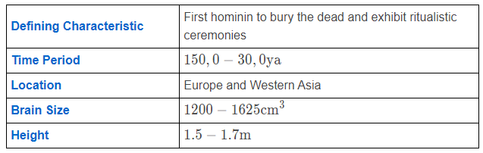
Homo neanderthalensis
Facts about Homo neanderthalensis:
• | Heavy boned
• | Large teeth and jaw muscles
• | Brow ridge above the eye sockets was nearly as prominent as in H. erectus
• | Limbs were relatively short with respect to torso, suggesting adaptation to the cold

Slide 11
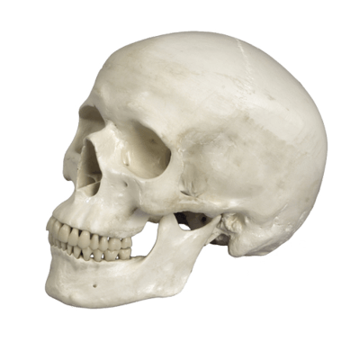
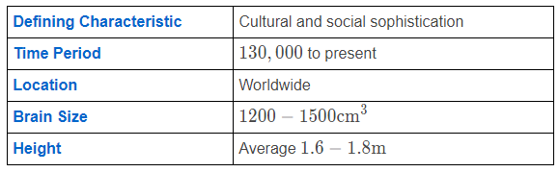
Homo sapiens

Slide 12
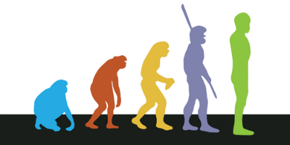
Evolutionary Pathways
When determining relatedness and possible evolutionary pathways for hominids, fossils are compared to each other and to modern humans and apes. Their ages are calculated using relative and absolute dating techniques. Their geographical distribution can also help explain possible evolutionary pathways.
It is often not obvious at which point a species has diverged, and sometimes there can be several possible hypothesises as to how different species are related.

Slide 13
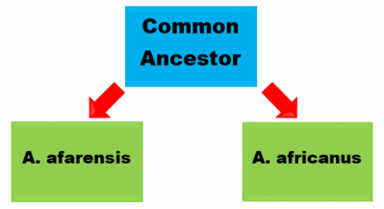

For example fossils of A.afarensis have been dated from 3.9−2.5mya, whilst fossils of A.africanus have been dated from 3.3−2.1 mya.
It is possible that both arose from a common ancestor.
Alternatively A.africanus may have evolved from a population of A.afarensis.

Slide 14

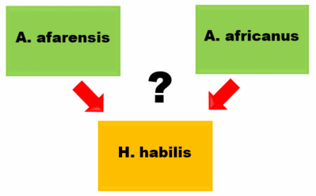
The only way to determine which pathway is correct is to find and date more fossils to help determine which is the correct pathway. At the moment, many suggested pathways are just "best guesses" based on the current evidence collected, but this may change as more fossils are discovered.
Due to fossil locations, it has been suggested that P. robustus evolved from A. africanus.
H.habilis possibly evolved from A. afarensis (although as fossils are also found in South Africa, they may have evolved from A. africanus).

Slide 15
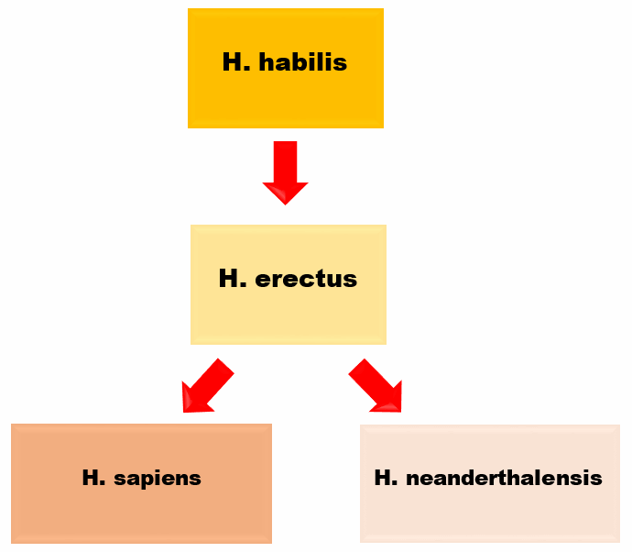
It is suggested that H. erectus may have evolved from H.habilis.
H. erectus is then thought to have evolved to form H. neanderthalensis and H. sapiens. Whilst the Neanderthals died out, the H. sapiens species spread out around the world, forming modern humans.

Slide 16
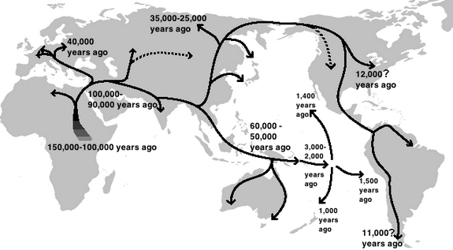
Out of Africa Theory
There have been several hypothesis put forward as to how humans have spread across the world, and their evolutionary pathways. One of the most popular theories is called the "Out of Africa Theory".

Slide 17
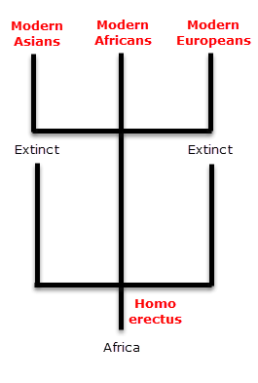
The Out of Africa Theory (also known as the replacement hypothesis), suggests that modern humans evolved in Africa, and migrated into the rest of the world, replacing existing hominin species which had descended from Homo erectus.

Slide 18

The Out of Africa model states that once Homo erectus had migrated from Africa, these populations became reproductively isolated.
As they were subjected to different environments and selection pressures, they evolved differently, and in some cases, into different species, such as Homo neanderthalensis.

Slide 19
Homo sapiens evolved in one area, which is most likely Africa.
These individuals then migrated out of Africa in the search for greater food resources.
Ultimately these Homo sapiens populations then out-competed the existing hominin populations in Europe and Asia.
This leads to the idea that human variation is a relatively recent phenomenon.

Slide 20
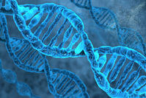
Genetic Evidence
Current Africans show more genetic diversity and variation than other human populations. Suggesting that their common ancestor was older, as there was more time for mutations to accumulate.
Also, endemic populations in areas other than Africa and the Near East have a relatively similar gene pool, suggesting that their common ancestor was younger than that of Africans.

Slide 21
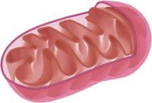
Mitochondrial DNA is a significant piece of the puzzle in terms of evidence for the Out of Africa Theory. Mitochondrial DNA (mtDNA) is the DNA present in the mitochondria of our cells, which is separate from our main genetic sequence in the nucleus.
mtDNA is only passed down through the maternal lineage (mother to child), meaning that it is easier to trace it's origins as it does not undergo independent assortment and recombination as our DNA does. The mutation rate of mtDNA is steady and so can be used as a biological clock.
Once again, modern African mtDNA has the greatest variation, suggesting that all human populations descended from a common ancestor in Africa approximately 200,000 years ago.

Slide 22
Fossil Evidence
Fossil evidence also supports the Out of Africa theory. The oldest Homo sapiens remains are from Africa, which indicates that the earliest anatomically modern humans were African.
African Homo sapiens remains have been found in:
• | Omo, Ethiopia dated 196,000 years old
• | Herto, Ethiopia dated between 154,000 and 160,000 years old
• | Southern Africa dated between 60,000 and 100,000 years old.
Whereas the oldest modern humans found in Europe date between 40,000 and 30,000 years old. Plus, the oldest upper Palaeolithic tools are only found in Africa.

